Slide 1


Slide 2

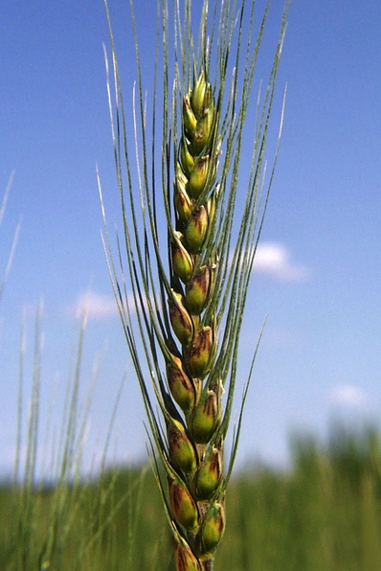
AGENDA
About the Office of the Chief Scientist (OCS)
USDA Coordination
Scientific Integrity
Strategic Planning and Program Evaluation
Looking Ahead
Questions

Slide 3
Office of the Chief Scientist (OCS)
Central office where key science issues and needs are identified
Coordinates with other Federal science agencies and White House Offices
Enhances Outreach and Awareness
science seminars
OCS Roadshow
Advises the Secretary of Agriculture and Departmental leadership
Raises the visibility of USDA Science
Chief Scientist shares high-priority science issues
Institutes, maintains, & enhances USDA’s Scientific Integrity Policy
Ensures Chief Scientist is the leading communicator of USDA Science nationally & internationally
science activities are coordinated and prioritized
working with professional societies
Ensures the quality, accuracy, and transparency of scientific and technical information supported by USDA

Slide 4
REE/OCS Leadership
Chavonda Jacobs-Young, Acting Chief Scientist & Agricultural Research Service Administrator
Dionne Toombs, Office of the Chief Scientist Director
Scott Hutchins, Deputy Under Secretary for Research, Education, and Economics Mission Area

Slide 5
OCS Staff Organization
USDA Chief Scientist
Director
Office of the Chief Scientist
Public Affairs Director
Strategic Planning and Program Evaluation Officer
Deputy Director
Public Affairs Specialist
Departmental Scientific Integrity Officer
Communications Fellow
Fellows (FEP and AAAS)
Senior Advisor for International Affairs
Administrative Assistant
Veterinary Science Policy Advisor
Senior Advisors
Food Safety &
Nutrition
Ag Economics & Rural Comm.
Agricultural Systems
Food Safety &
Nutrition
Ag Economics & Rural Comm.
Renewable Energy/
Nat. Res. & Environ.
Animal Health and Production
Agricultural Systems
Animal Health and Production
Plant Health and Production
Plant Health and Production

Slide 6
USDA Cross-Department Coordination
Office of the Chief Scientist
USDA Agencies
USDA Science Council
Facilitates cross-Department coordination and collaboration among all USDA agencies
Informs policy and program decisions to assure that science informs policy

Slide 7
USDA Science Council
OCS convenes the USDA Science Council to further facilitate scientific coordination and collaboration across USDA
Education Coordinating Committee
Emerging Technologies Team
Remote Sensing Coordinating Committee
Joint Committee on Biorisk Management Policy
International Committee
Statistics Committee

Slide 8
Other OCS Coordination:
White House Office of Science and Technology Policy (OSTP)
USDA Chief Scientist is the USDA representative on principal committees making up the National Science and Technology Council (NSTC) in OSTP
OCS tracks which USDA employees are representing the Department on National Science and Technology Council entities
OCS coordinates review of NSTC documents requiring Departmental clearance by the Chief Scientist
Notes:
USDA is the only Department that works to ensure a safe, nutritious, and a secure food supply from farm-to-fork.
To feed 2 billion more people in the world — as is expected by 2050 — our work will need to continue.
We recognize nutrition could be one of the most cost-effective approaches to address many of the societal, environmental, and economic challenges facing nations across the globe today.
These challenges include the morbidity, mortality, and economic burden associated with chronic diseases and disorders such as obesity.
Our collaborative USDA approach is a multi-faceted, from increased agriculture production to the administration of 15 federal nutrition assistance programs including WIC, SNAP, and school meals.
Collectively, these programs serve millions of expecting mothers; infants and children in childcare and school; and low-income families going to food banks; local farmers markets; and local supermarkets.
These investments also support education, health care, and a competitive workforce.
Ensuring products with the highest nutritional value is also a key ingredient to our Department’s role in promoting the free flow of agricultural trade.

Slide 9
Other OCS Coordination:
Foundation for Food and Agriculture Research (FFAR)
Authorized by Congress as part of the 2014 Farm Bill, the Foundation for Food and Agriculture Research (FFAR) operates as a non-profit corporation leveraging public and private resources to increase the scientific and technological research, innovation, and partnerships
FFAR Ex Officio Board Members include Secretary Perdue, ARS Administrator Dr. Jacobs-Young, and NIFA Director Dr. Angle
The REE Under Secretary is delegated by the Secretary to lead the USDA review of proposed FFAR activities to ensure that the FFAR’s work complements, rather than duplicates, USDA activities
OCS coordinates review of FFAR proposals for program areas and requests for funding to ensure activities are complementary to USDA activities

Slide 10
Other OCS Coordination:
Stakeholder Activities: National Agricultural Research, Extension, Education, and Economics Advisory Board (NAREEE) (1996)
NAREEE is legislatively mandated to review the relevance and adequacy (R&A) of funding of REE research as specified in the REE Science Plan.
OCS annually compiles agency data and drafts an Executive Summary for the NAREEE R&A committee to use as a guide in their review
OCS serves as experts and advises on USDA policy to the NAREEEAB, as requested

Slide 11
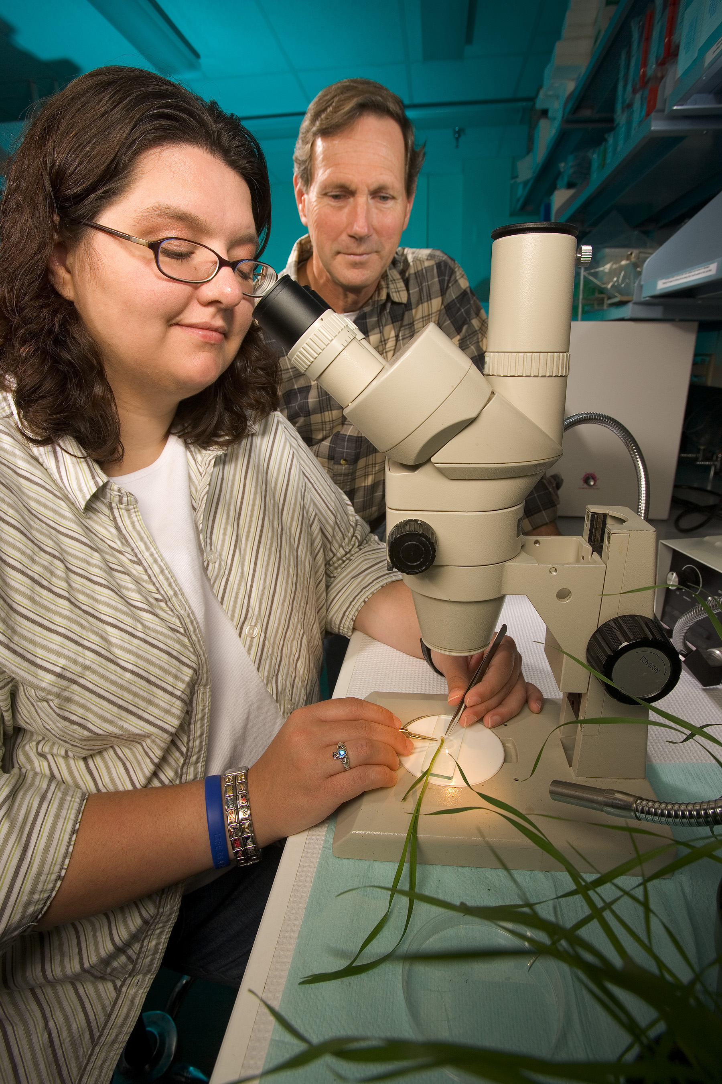
Scientific Integrity
Promote a culture of scientific integrity as the norm
  Develop and implement training materials
Ensure the quality, accuracy and transparency of scientific and technical information supported by the USDA
Ensure scientific communication free of political interference
Ensure dispute resolution mechanisms are in place
Notes:
USDA is the only Department that works to ensure a safe, nutritious, and a secure food supply from farm-to-fork.
To feed 2 billion more people in the world — as is expected by 2050 — our work will need to continue.
We recognize nutrition could be one of the most cost-effective approaches to address many of the societal, environmental, and economic challenges facing nations across the globe today.
These challenges include the morbidity, mortality, and economic burden associated with chronic diseases and disorders such as obesity.
Our collaborative USDA approach is a multi-faceted, from increased agriculture production to the administration of 15 federal nutrition assistance programs including WIC, SNAP, and school meals.
Collectively, these programs serve millions of expecting mothers; infants and children in childcare and school; and low-income families going to food banks; local farmers markets; and local supermarkets.
These investments also support education, health care, and a competitive workforce.
Ensuring products with the highest nutritional value is also a key ingredient to our Department’s role in promoting the free flow of agricultural trade.

Slide 12
Strategic Planning and Program Evaluation
Annual reporting of significant accomplishments supporting the USDA research goals
Identify and leverage key components of the agricultural research and delivery system to that support the USDA Strategic Goals

Slide 13
Vision
Strengthen Science Leadership
Enhance Outreach and Awareness
Improve National Coordination

Slide 14
Questions?
THANK YOU!
Dionne.Toombs@osec.usda.gov
Office: 202-720-3444

