Slide 1
UC, transforming scholarly communications, updates on Cambridge & Elsevier
Rice Majors, Associate University Librarian for Scholarly Resources
@ricemajors

Slide 2
1 What’s at stake?
“Imagine if instead we said we will no longer conceal cancer’s secrets in a paywall journal [...] and instead make all that we know open to everyone so that the world can join the global campaign to end cancer in our lifetimes? [...] This question matters.”
Joe Biden, (at the time) Vice President of the USA (2016)
https://medium.com/cancer-moonshot/here-s-what-the-vice-president-said-to-the-largest-convening-of-cancer-researchers-in-the-country-3007bb196dbd
Notes:
It’s an awesome time to work in scholarly communications. If you’re at all anything like me, you want to get up every morning and be fired up about your work because you know it makes a difference - not just to your library, or your university, but to the boundless enterprise of science, discovery and progress. I know I am preaching to the choir when I tell you that I can’t think of anything more worthwhile to work on than to advance open access. [click] This quote comes from a very different political moment than the one we face today, but the sentiment holds: when researchers can build on each others work immediately and without barriers, we can advance even the most vexing questions, whether it’s cancer or any other of the major questions we face as humankind.

Slide 3
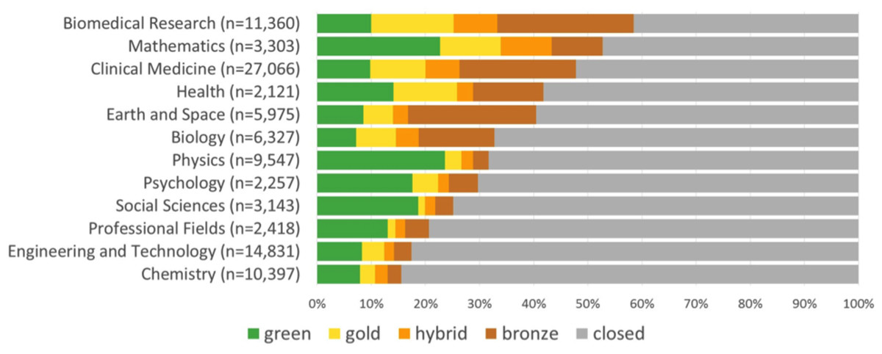
2 The state of scholarly communication at UC
UC authors contribute to 50,000 articles per year
Only 15% of these are freely available in their final published form
(For Elsevier this is 6%)
Notes:
These notions of open access align quite nicely with the University of California’s public service mission: “The distinctive mission of the University is to serve society as a center of higher learning, providing long-term societal benefits through transmitting advanced knowledge.” One way that we do this is by publishing our research results as peer-reviewed, scholarly articles. And the more people who can read those scholarly articles, the more we fulfill our mission of transmitting advanced knowledge.
And we’re a knowledge generation powerhouse: UC authors publish 50,000 articles a year. But the current business model of the publishing industry severely hurts how well we transmit advanced knowledge. Only 15% of our articles are freely and immediately available for anyone to read in their final published form. The number is much lower for the largest publisher, Elsevier, which makes only 6% of our articles freely available at the time of publication.
Here’s a health-check of how far we’ve come to date with OA. There’s plenty of room to move because in the 25 years that open access has existed as an idea, we’ve only gotten so far. “Grey” and “closed” is still dominating the landscape in this graph created by the good folks from ImpactStory and their collaborators.

Slide 4
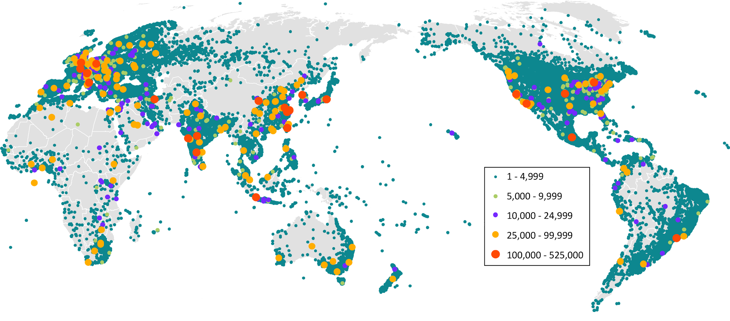
Even so: UC Open Access impact
https://accountability.universityofcalifornia.edu/2019/chapters/chapter-9.html
Notes:
For example: More than ever, the Elsevier walk-away has reinforced our appreciation for green OA copies of articles available in repositories; as well as the continued importance of supporting UC faculty and staff in making their own article available in our eScholarship repository. This map shows the reach of UC’s green OA copies across the globe - a heartwarming sight!

Slide 5
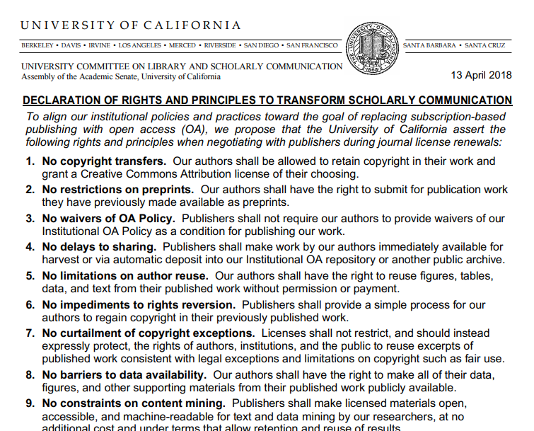
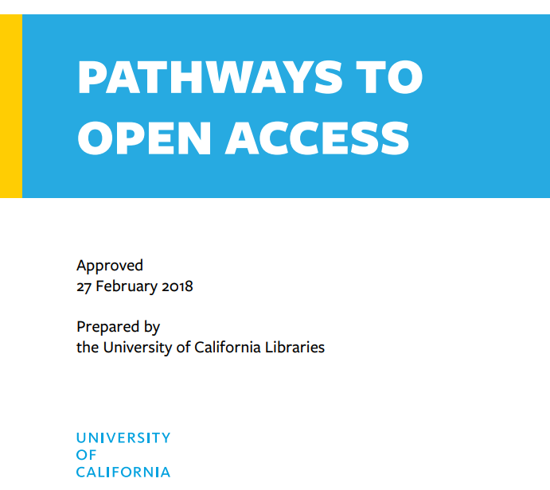
3 Faculty: The Declaration of Rights and Principles
Notes:
At the center of our OA universe at the University of California are not the libraries, but the faculty. In 2018, our academic senate library committee issued a Declaration of Rights and Principles. I’ve heard that Rich Schneider, the chair of the committee at the time, discussed this document with you last year, and he created quite a stir.
That same year, the UC libraries issued a comprehensive Pathways to Open Access plan, laying out all of the avenues for engagement and investment open to the UC Libraries, and, for that matter, the broader community. These Pathways, if you will, represent the practical and tactical ways in which the values of the Declaration of Rights and Principles can be instantiated.
In a community as diverse as the UC, this Pathways approach ensures that all can find a meaningful way to contribute to the big project of getting to 100% open access, and see themselves and their priorities reflected.

Slide 6
4 The money: Today...
*Only 15% of UC authored articles are immediately OA
Notes:
And here’s another “why,” this time focused more on the financials. In the UC, we are paying publishers with the left hand, and with the right hand. The UC Libraries spend $40 million with publishers for our systemwide subscriptions, and for our researchers to be able to read. And our faculty members spend an additional $10 million, out of grants and other research funds, to publish open access. In other words, our faculty are contributing 20% of the overall spend that goes towards enabling publishing and reading at the UC. All of that only buys us 15% open access. And, of course, the costs for subscriptions increase every year. In the UC, the OA spend increases every year as well: our faculty have spent 15-20% more on APCs every single year of the last three years.

Slide 7
Outcomes to date
Cambridge University Press
Elsevier
Support for the OA movement

Slide 8
Transformative agreement with Cambridge University Press
Favorable pricing for publishing OA
UC negotiated a 30% discount on OA publishing fees
Library then pays the first $1,000
Authors without grant funding are fully funded by the Library
Includes 80% of Cambridge journals with more being added as Societies agree
Authors always have academic freedom to opt out

Slide 9
The Author Experience: incentivizing OA
● Library financial transactions are handled in aggregate each quarter ●
Notes:
Our authors can altogether opt out of OA - we respect their academic freedom to do so. Once they’re on an OA path, a library subvention and an author grant pay the APC; alternatively, if the author has no grant or research funding available, the library either pays in full. All authors can now participate in open access without any barriers.

Slide 10
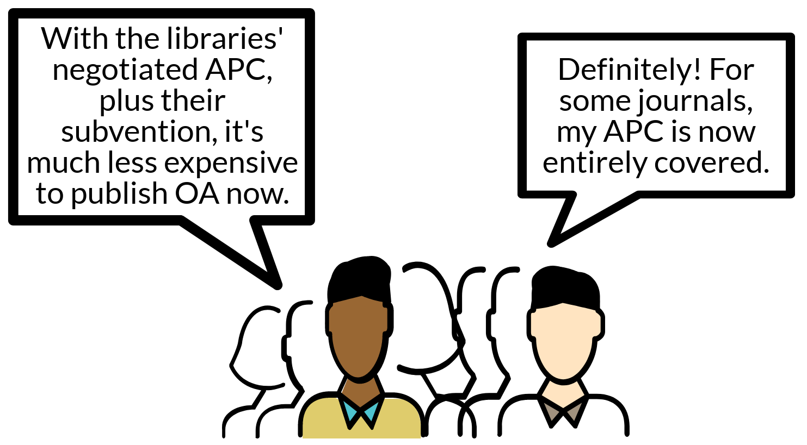
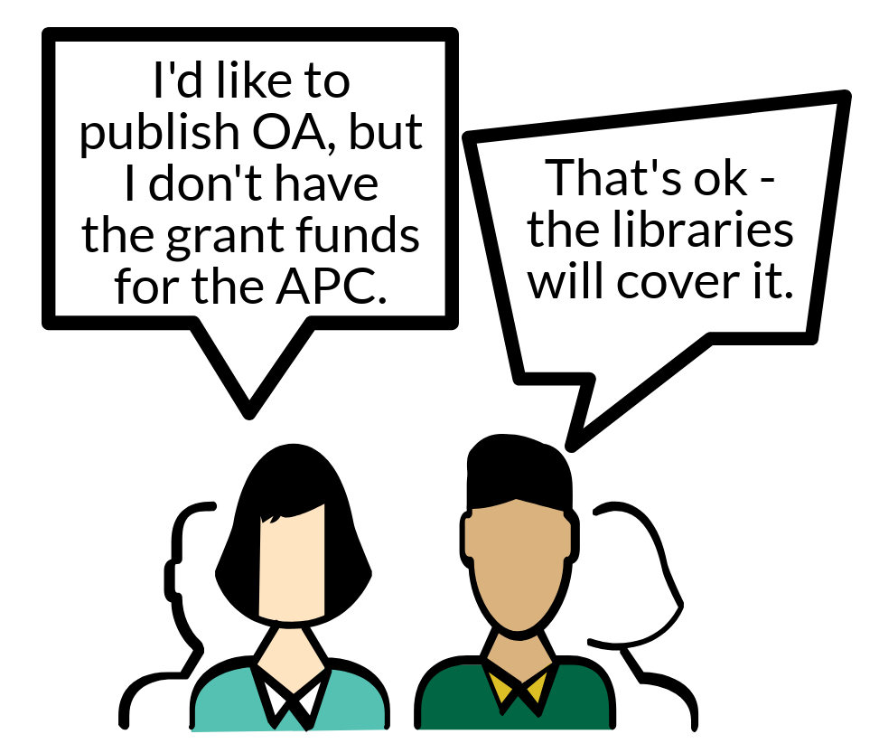
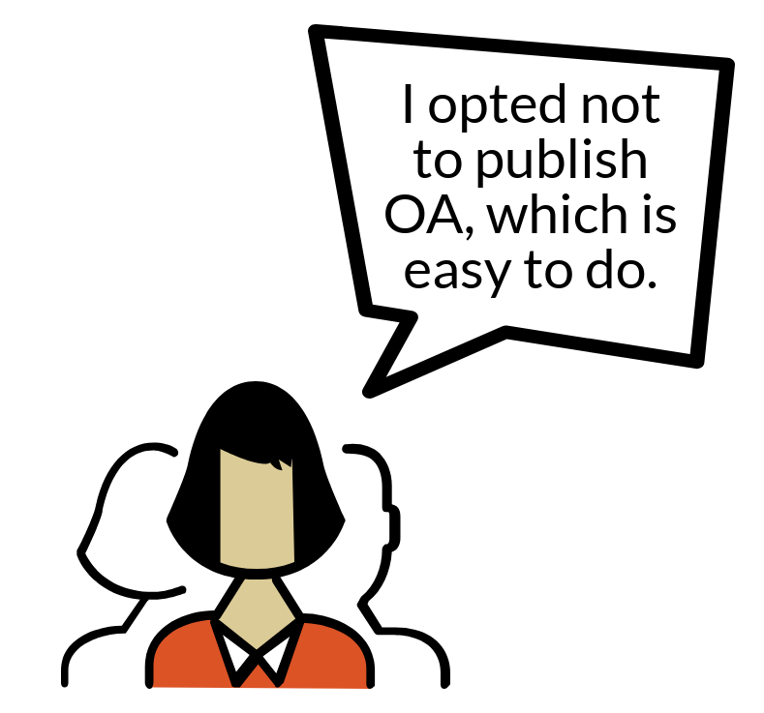
Benefits for authors
Notes:
Those who have already spent their own grant funding will now find that publishing open access is cheaper, because of the library subsidy. Those who have not been able to publish OA before because they don’t have grants will now find that the library has their back, and they too can enjoy the benefits of OA. And, of course, those who don’t want to participate at all can simply opt out.

Slide 11
Elsevier: Negotiations stalled over cost containment
The Academic Senate and the Libraries agreed not to accept Elsevier’s last proposal in February 2019, which:
Included no cap on the total amount that UC would pay
Cost increases would be passed on to faculty under Elsevier’s model
Would prevent the Library from covering article fees for authors lacking grants or other research funds
Would preclude authors publishing open access in high-profile journals such as those from Cell Press and The Lancet
Notes:
However, our negotiations with Elsevier also had a second goal, of containing costs, and it was around this goal that we were unable to find common ground.
You may be aware that Elsevier’s price increases have greatly outpaced inflation over the years and the University is paying unsustainably high prices for journal articles -- which are, in many cases, written by our own faculty. The Academic Senate agreed that Elsevier’s proposed terms were unacceptable and that UC should spend taxpayer money responsibly when entering into agreements with commercial publishers.
The terms of Elsevier’s final proposal to the University included no cap on the total the University might pay overall, which could soar to an additional 10 million dollars per year in addition to the 11 million dollars per year that the Libraries paid last year in subscription costs.
The Elsevier proposal also included terms that would have disallowed the Library from sharing the costs of article fees for researchers without the funds to pay them, and it excluded some of the most high profile journals from being eligible for our open access terms.
We have been stalled in negotiations since the end of February 2019. The University remains hopeful that Elsevier will be willing to address that address the concerns we have raised with them, and we have communicated to Elsevier the kinds of changes we would need to see in such a proposal.

Slide 12
Status of Elsevier discussions
Current status of negotiations:
Negotiations stalled; no formal negotiations since spring 2019
Some cordial ad hoc communications
UC hopes to reenter formal negotiations if Elsevier indicates that willingness to address our goals
Competing public narratives
UC team working hard to clarify and fact-check
osc.universityofcalifornia.edu
Notes:
There have been no negotiating sessions since negotiations broke down earlier this year.
However, when members of UC’s negotiating team have bumped into Elsevier’s negotiators, at conferences for example, the interactions have reportedly remained cordial and both sides continue to express a desire to find a way forward.
There has also been an extensive amount of discussion of the situation in the mainstream and higher ed media, with details that don’t always line up.
The UC team has been working hard to clarify these areas of confusion.
The UC’s Office of Scholarly Communication has published a rich trove of information, including:
an open statement on why UC walked away from the negotiations earlier this year
a fact-check that corrects some of the misleading statements Elsevier has been making in the media and on their own webpage
and a lengthy FAQ.

Slide 13
Access: What is affected and what is not
What is affected:
What is NOT affected:
2019 articles
Pre-2019 articles in certain journals
Most articles published in 2018 or earlier
Open access articles
E-books and other products
Notes:
Elsevier has discontinued UC’s access to:
All articles with a 2019 publish date
Older articles in certain journals for which the UC’s prior contract did not include permanent access
But you can still access the following content in the same way you always have:
Most Elsevier articles published in 2018 or earlier: You will still be able to access the full text of many articles via ScienceDirect because UC’s prior contracts included permanent access to previously published content in most Elsevier journals.
Open access articles: If the author paid the article processing charge to make their article open access, the article you’re seeking may be available from the journal’s website -- so it’s always worth checking, even if you know it was published in 2019.
Elsevier e-books and other products licensed by the UC (e.g., Compendex, Reaxys, INSPEC) or by <<your local campus>> are covered under separate contracts and remain available as before.

Slide 14
As an example: How the UC Davis Library is supporting users through the standoff
Interlibrary loan:
Prompt delivery when open access versions are available
Added weekend hours (Sat 12pm-5pm, Sun 10am-5pm) and evening hours (Mon-Thu until 9:30pm) for processing requests
Accelerated normal article delivery to be one business day turnaround
Purchase on-demand option: Urgent requests will receive priority handling
Library can purchase individual articles for urgent needs
Self-service: Tips on library website for finding open access / other free versions
Notes:
To support you as best we can, the UC Davis Library has added service hours on the weekends and on weekday evenings so that we can process article requests. These extended hours will continue through the summer and until an agreement with Elsevier may be reached. We have also entered into new agreements with other research libraries and medical libraries to get accelerated delivery service with a one business day turnaround.
For articles needed urgently for patient care or for an imminent grant deadline, the Library can also purchase articles for you through a commercial delivery service -- the Library will absorb these costs.
For those of you who prefer to try finding articles yourself, we have also posted some tips on our website that you may find helpful. Our website address will be on the next slide.

Slide 15
UC researchers with relationships to Elsevier
Publishing with Elsevier:
Status quo: publish behind the paywall or pay open access fee
Faculty decide where to publish, review, and edit
Many faculty members have resigned editorial positions
Reading Elsevier articles:
UC owns permanent access to many of the journals through 2018 -- we can still access these on ScienceDirect
The Library will support all campus users to get the articles they need
Notes:
The University is now out of contract for Elsevier’s journals, although other Elsevier products such as ebooks and Scopus are under different contracts and remain available.
This is not as dire as it may sound at first -- the University owns permanent access to articles published through 2018 for many journals -- in fact, we own 86% of the articles we had been licensing, which represents 95% of the University’s usage. Articles that we own will still be available to the campus users via ScienceDirect.
For articles published in 2019 and beyond, and for articles from those journals where the University does not own the backfiles, the Library will support all of our users in getting access to the articles needed for the clinical, research, and instruction needs of the campus community.

Slide 16
UC faculty reaction
“Boycott ELSEVIER and support affordable, open-access scholarly publishing” (https://www.change.org/p/elsevier-boycott-elsevier-and-support-affordable-open-access-scholarly-publishing)
“Support the UC's "publish & read" proposal to Elsevier” (https://petitions.moveon.org/sign/support-the-ucs-publish?r_hash=R6c4swQv&source=s.tw)
The Cost of Knowledge (http://thecostofknowledge.com/)
Notes:
Overall, there have been surprisingly few complaints about the loss of 2019 content. On the contrary, we’ve seen a good bit of anecdotal evidence on social media that our faculty, on their own initiative, our now withholding their labor from Elsevier. And there are also a number of more formal efforts to organize the whithholding of labor, as in the example of 30 cell press editors who have suspended their editorial duties. Just to be abundantly clear: the UC libraries had nothing to do with any of these boycotts. These are grassroots faculty efforts.

Slide 17
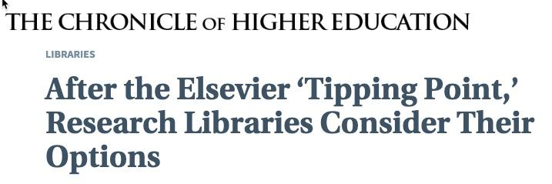
Global Reaction
Global coalition

Slide 18
UC has multiple other parallel initiatives
eScholarship as publishing infrastructure
Already hosts 90+ open access journals
Elsevier stand-off has caused increase in queries from faculty for more
$2.2M Arcadia grant (including CDL) will allow services to mature further
Transitioning Society Publishers to Open Access (TSPOA)
Dryad repository for research data
Toward an Open Monograph Ecosystem (TOME) – UC Davis
OER initiative for open STEM textbooks (led by UC Davis) received $4.9M from DoE in 2018
Notes:
eScholarship is not just a repositiory - it’s also a publishing platform currently hosting 90+ open access journals. And as a result of the high-profile Elsevier stand-off, the team running eScholarship is now receiving a pronounced increase in queries from faculty about launching new open access journals. A recently announced $2.2M Arcadia grant will allow us and our partners to further advance the maturity and professionalization of library publishing services.
A group of like-minded individuals from libraries, academic institutions, publishers, and consortia have organized to connect society journal editors and publishers with support and useful resources to transition society publications to open access.
TSPOA helps connect societies, editors, and libraries with localized groups and individuals, and offers consultative services to support OA transitions
TSPOA evaluates opportunities to support or encourage new society journal OA publishing models or projects, and is organizing a pilot to this effect.
TSPOA conducts outreach and presentations to help societies, libraries, and other stakeholders understand how to support OA publishing by societies.
If you’d like their help transitioning your journal or to participate in a pilot, you can go to tspoa.org to get contact information.
We also deeply care about the open availability of research data. CDL has partnered over the last year with Dryad to re-launch this well loved general repository, which was founded by researchers 10 years ago. We do not want research data to follow the same fate as research publications, and be under the de-facto control of commercial entities. Reflecting on where we are with publishers today, we made this investments so viable community owned alternatives to publisher offerings exist in the data sharing space.

Slide 19
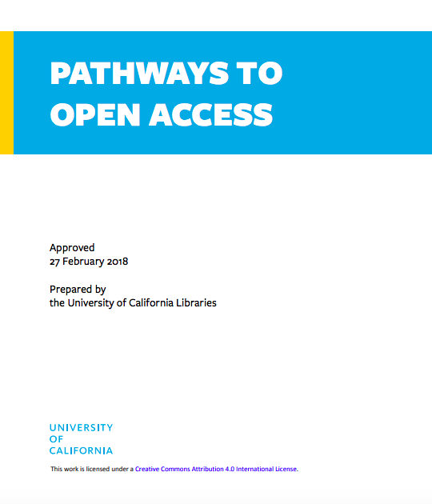
UC is supporting all journeys to OA
On our OSC website:
Pathways to OA Toolkit (Feb 2019)
Negotiating with Publishers toolkit (May 2019)
Events:
Choosing Pathways to Open Access Forum (Oct 2018)
Open Access tipping point workshop (Aug 2019)
Co-sponsored by the UC Academic Senate and the Libraries
Institutions participated in dyads of a faculty member and the library director / university librarian

Slide 20
Zoom in, zoom out: why open access matters
Appropriate use of research funding, especially public funds
Social justice
Expand the reach of your research
Industry, government agencies, public policy discourse, independent scholars, K-12, journalists, community health organizations…
Improve your own access by eliminating paywalls
Enable transformative usage via open licensing

Slide 21
What you can do!
Build a faculty + library coalition
Faculty
your open access values are beating heart of the coalition
Librarians
bring open access to life by advancing your faculty’s values
Notes:
If you’d like to learn more about transformative agreements, the UC Libraries have been eager to be a resource, and as I’ve already mentioned we’ve broadly published information about our model and our experience. I think it’s a particularly powerful path because faculty want to continue publishing in the publisher-supplied journals they know and value. Transformative agreements bring OA to your faculty, rather than insisting that your faculty change their behavior to find OA. Join us in exploring that path if that sounds intriguing. I have just spent two days at the OA2020 meeting of chief negotiators, where representatives from over 30 countries discussed the impressive progress the community has made in building coalitions for transformative agreements. Hungary announced that by next year, over 80% of its research will be published open access. Or join us on any of the other pathways we’re currently pushing ahead on. I’m happy to introduce you to the folks moving ahead this good work.
In closing, I’d urge you to seize this Open Access moment, and continue your journey with added vigor, as well as an open mind. And I’d urge you to go on that journey in a way the builds and expands our collective community.

Slide 22
Questions & discussion
@ricemajors
ramajors@ucdavis.edu

